Slide 1

MOBILE DATASET ANALYSIS
BY- MANISHA GOYAL (36)
SHALU JAIN (24)
PRIYAL JAIN (25)
LOVE GOEL (04)
DHRUV (01)

Slide 2



INTRODUCTION TO PROJECT
This project involves the analysis of the mobile dataset, which encompasses detailed information on the sales of mobile phones. Using SQL Queries, we analyise data to provide valuable key insights, identify patterns, and generate meaningful recommendations that can drive business growth and strategic decision-making.

Slide 3
MAIN OBJECTIVE
The primary objective is to perform an in-depth analysis of the mobile dataset, addressing key questions related to units sold,product category wise, and more. The scope includes data cleaning, and creating supporting tables for detailed analysis. We will also explore trends in operating profits, sales method, and more to provide actionable insights.

Slide 4

DATA ANALYSIS
USING SQL

Slide 5


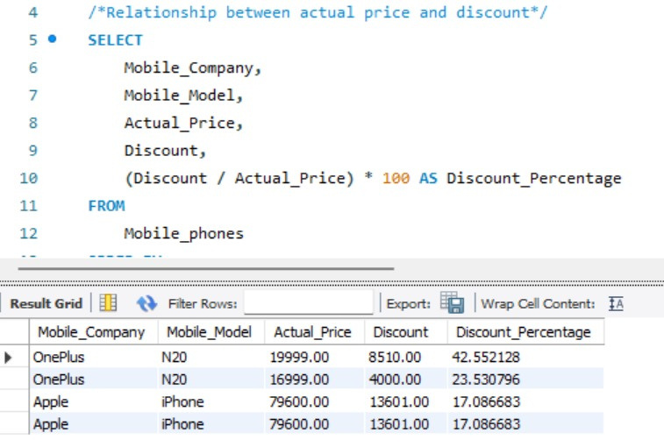
ANALYSIS NO.1
What is the relationship between the actual price and the discount offered across different mobile companies?
OnePlus N20: The OnePlus N20 has two different discount percentages: 42.55% and 23.53%. This could be due to different promotions or sales for the same model.
Apple iPhone: The Apple iPhone has a consistent discount percentage of 17.09%. This might indicate a uniform pricing strategy for this model.
Comparison: Overall, the OnePlus N20 has higher discount percentages compared to the Apple iPhone, suggesting that OnePlus might be offering more aggressive discounts for their products.

Slide 6
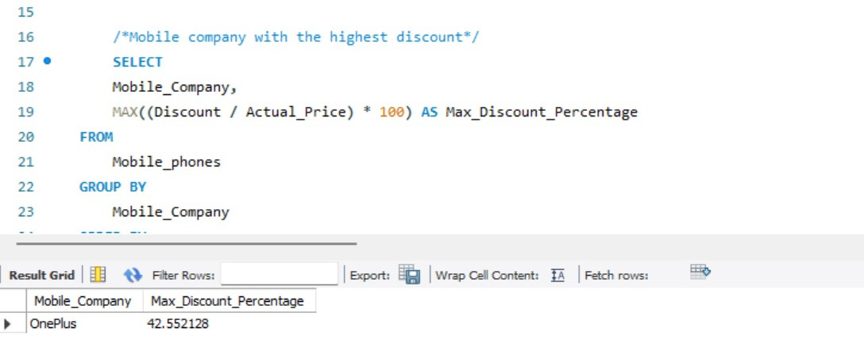
ANALYSIS NO.2
Which mobile company provides the highest discount in percentage terms?
Based on the result grid, we can identify the mobile company with the highest discount percentage. In this case, the company with the highest discount percentage is OnePlus with a maximum discount of 42.55%.

Slide 7
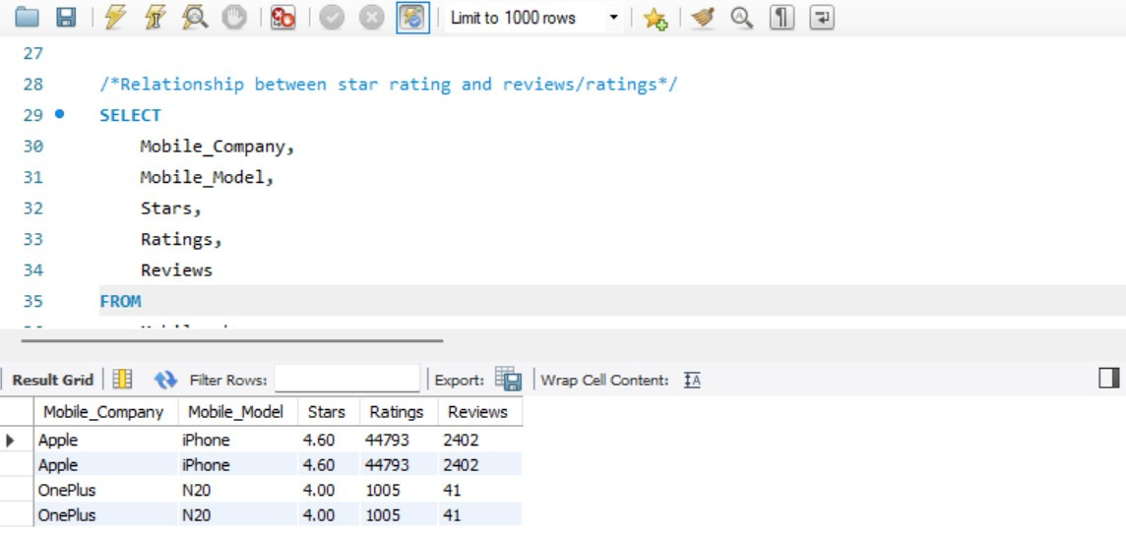
ANALYSIS NO.3
How does the star rating affect the number of reviews or ratings for different mobile models?
Apple iPhone: The Apple iPhone has a high star rating of 4.60, along with a large number of ratings (44793) and reviews (2402). This suggests that the iPhone is generally well-received by customers.
OnePlus N20: The OnePlus N20 has a lower star rating of 4.00 compared to the iPhone, and also has significantly fewer ratings and reviews (1005 and 41 respectively). This could indicate that the N20 has received less attention or customer feedback.

Slide 8
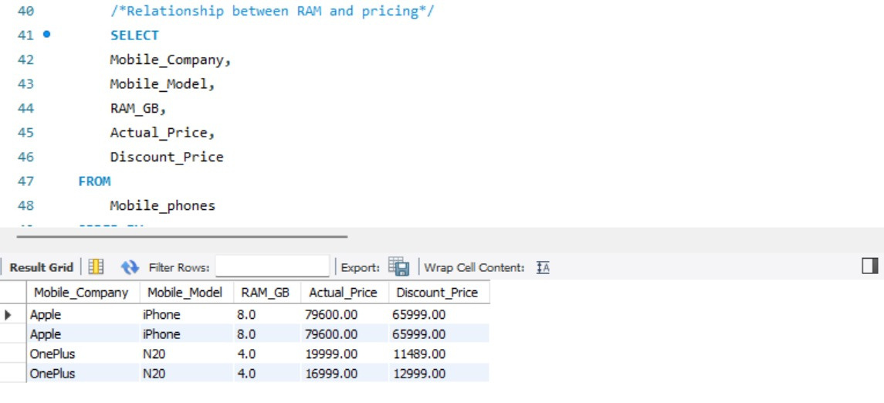
ANALYSIS NO.4
Is there a noticeable trend between the RAM size and the pricing (actual or discounted) of mobile models?
The SQL query analyzes the relationship between RAM and pricing for different mobile phone models. It retrieves data on the mobile company, model, RAM size in GB, actual price, and discount price from the Mobile_phones table. The result grid shows that the Apple iPhone with 8GB RAM has a higher actual and discount price compared to the OnePlus N20 with 4GB RAM, suggesting a potential correlation between RAM size and pricing.

Slide 9
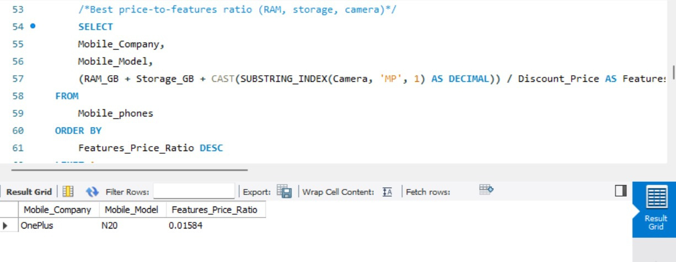
ANALYSIS NO.5
Which mobile model offers the best value in terms of price-to-features ratio, considering RAM, storage, and camera quality?
The SQL query calculates the best price-to-features ratio for mobile phones by considering RAM, storage, and camera specifications. It assigns a numerical value to each feature based on its quantity (e.g., GB for RAM and storage, MP for camera) and divides the total feature value by the discount price. The result grid shows that the OnePlus N20 has the highest price-to-features ratio, indicating it offers the best value for its price among the analyzed models..

Slide 10
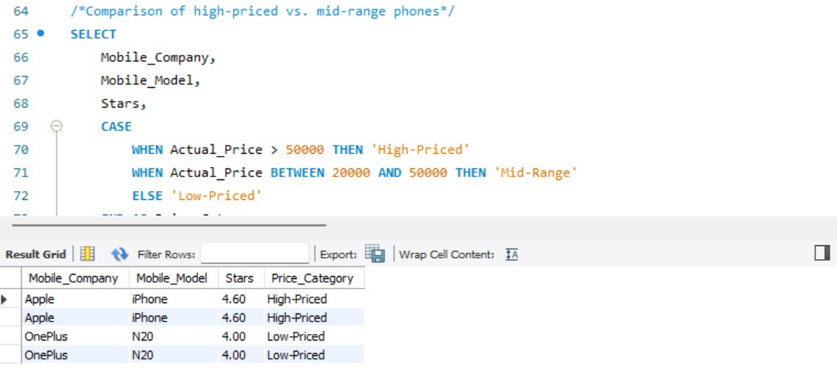
ANALYSIS NO.6
Do higher-priced mobile phones have significantly better ratings compared to mid-range models?
The SQL query categorizes mobile phones into "High-Priced," "Mid-Range," and "Low-Priced" based on their actual price. It then retrieves information on the mobile company, model, star rating, and price category. The result grid shows that Apple iPhones are classified as "High-Priced," while OnePlus N20s are considered "Low-Priced." This analysis helps identify the price range of different mobile phone models and their corresponding star ratings.

Slide 11
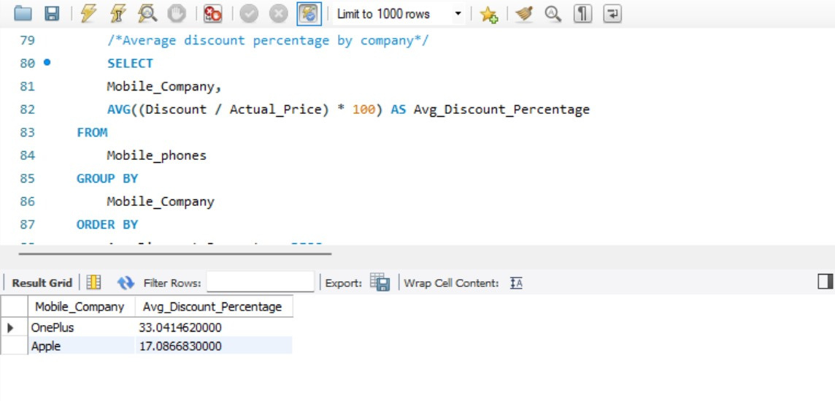
ANALYSIS NO.7
What is the average discount percentage offered by each mobile company?
The SQL query calculates the average discount percentage for each mobile company. It retrieves data on the mobile company and discount information from the Mobile_phones table. The result grid shows that OnePlus offers an average discount of 33.04%, while Apple's average discount is 17.09%. This analysis helps compare the overall discount strategies of the two companies.

Slide 12
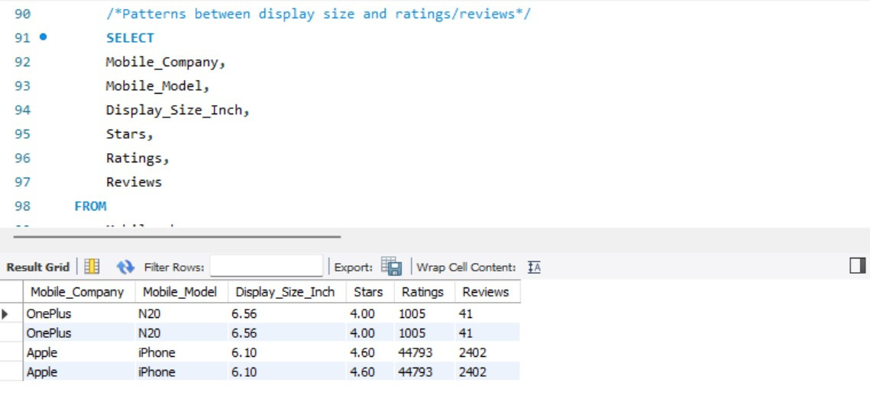
ANALYSIS NO.8
Are there any patterns between the display size and the customer ratings or reviews?
The SQL query analyzes the relationship between display size and ratings/reviews for different mobile phone models. It retrieves data on the mobile company, model, display size, star rating, number of ratings, and number of reviews from the Mobile_phones table. The result grid shows that the Apple iPhone with a 6.10-inch display has significantly higher ratings and reviews compared to the OnePlus N20 with a 6.56-inch display. This suggests that display size might not be a primary factor in determining customer satisfaction.

Slide 13
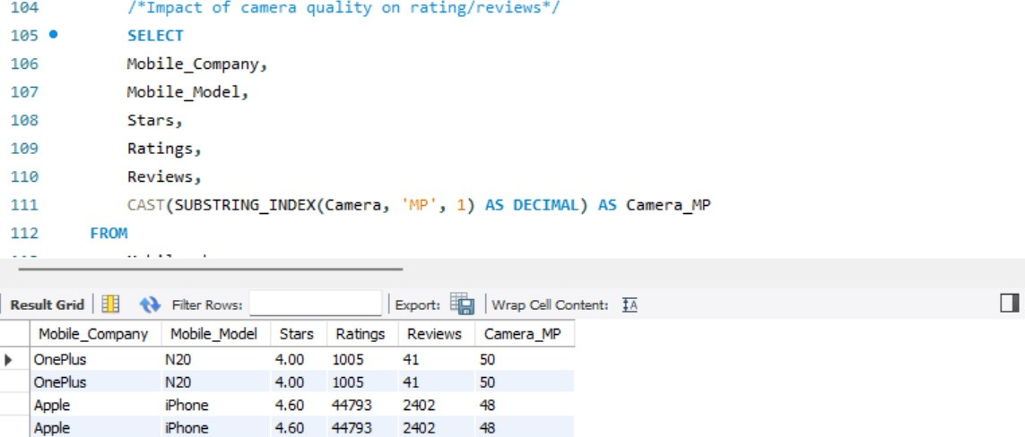
ANALYSIS NO.9
How does the camera quality (measured in MP) impact the mobile phone’s rating and reviews?
The SQL query analyzes the relationship between camera quality (measured by megapixels) and ratings/reviews for different mobile phone models. It retrieves data on the mobile company, model, star rating, number of ratings, number of reviews, and camera megapixels from the Mobile_phones table. The result grid shows that both OnePlus N20 and Apple iPhone have the same camera megapixel count (50), but the iPhone consistently receives higher ratings and reviews.

Slide 14
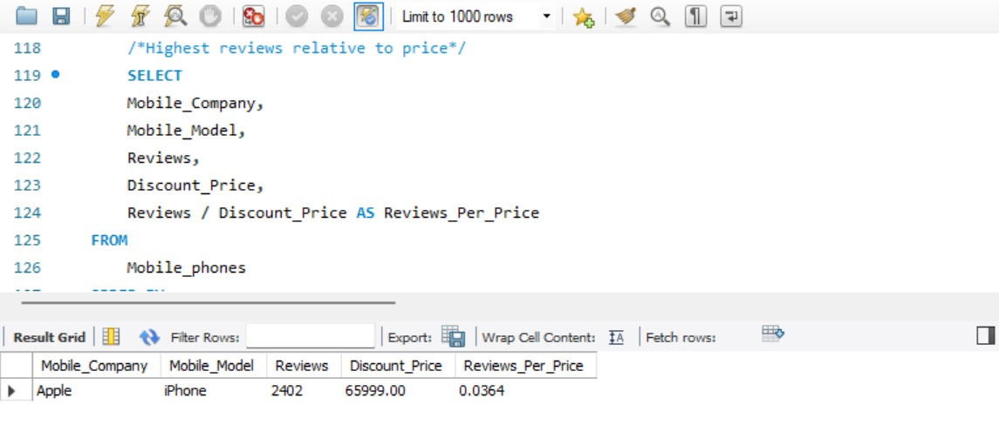
ANALYSIS NO.10
Which mobile model receives the highest number of reviews relative to its pricing or discount offered?
The SQL query calculates the highest reviews-per-price ratio for mobile phones by dividing the number of reviews by the discount price. It retrieves data on the mobile company, model, reviews, and discount price from the Mobile_phones table. The result grid shows that the Apple iPhone has the highest reviews-per-price ratio (0.0364), indicating that it received a relatively high number of reviews compared to its discounted price.

Slide 15



SUMMARY
Provides a comprehensive overview of mobile sales data, including total sales, average sales, customer ratings, storage capacities, price segments, and company performance. By analyzing these metrics, companies can identify top-selling brands, understand customer preferences, and optimize their pricing and product offerings.

Slide 16



THANK YOU

